Slide 1


Department of Information Science and Engineering
Department of Information Science & Engineering
Major Project Phase 01 – Review
O.A.S.I.S: Open-Source Audio-Visual Summarization and Insight System
Project Batch - 007
Shravan Kumar Soni | 1NT23IS202
Srusti S | 1NT23IS219
Surendra Tripathi | 1NT23IS226
Vivek Singh | 1NT23IS251
Guide Name, and Designation
Mr. Prashanth BS, Assistant Professor
Dept. of IS&E
June 04, 2026

Slide 2
Contents
Introduction
Literature Survey
Outcome of Literature Survey/Research Gap/Motivation
Problem Statement
Objectives
Methodology
Architecture
References

Slide 3
Introduction
This chapter introduces the O.A.S.I.S project, the problem it addresses, the overall system design, and the technologies used in the prototype. It also outlines the structure followed in the rest of the report.
1.1 Overview and Need for the System
Long form video content such as business meetings, lectures, and documentaries is difficult to review efficiently. Identifying who said something, when it was said, and what was visible on screen at that time usually requires long periods of manual searching. Existing systems often focus only on transcripts, fail to preserve long range chronology, or produce generic summaries that do not answer user specific questions. O.A.S.I.S is designed to convert such recordings into time anchored, query-able knowledge assets using open-source multimodal processing.
1.2 Pipeline Overview
The O.A.S.I.S prototype follows a six-stage pipeline consisting of preprocessing, transcription with speaker diarization, visual scene understanding, multimodal fusion, model benchmarking, and dashboard-based visualization. The six-stage pipeline and its data flow are shown in Figure 5.1. Each stage produces structured outputs that are consumed by the next stage, making the system modular and easy to inspect.

Slide 4
Introduction
1.3 Technology Stack
The system uses FFmpeg for video preprocessing, WhisperX and wav2vec2 for transcription and alignment, Pyannote for speaker diarization, Moondream2 for visual understanding, and open weight language models such as Qwen, Llama, Mistral, and Gemma for reasoning and summarization. PyTorch, Transformers, and bitsandbytes are used for model execution and quantized inference. Streamlit is used to build the dashboard interface for viewing outputs and benchmark metrics.
1.4 System Output and Utility
The final system produces timestamped transcripts, speaker identified dialogue, visual scene descriptions, model wise summaries, and benchmark statistics in a form that is easy to inspect. This makes the prototype useful not only for summary generation but also for reviewing meetings, tracing speaker contributions, and comparing open source model behavior on long videos.
1.5 Scope
The scope of O.A.S.I.S covers end to end processing of long form videos through audio extraction, speaker aware transcription, keyframe based visual context generation.

Slide 5
Literature Survey
This chapter reviews major research directions related to long form video understanding, meeting summarization, query-based summarization, and benchmarking of large language models.
2.1 Long Form Video Language Understanding
2.1.1 HourVideo
HourVideo presents one hour video language understanding with questions on summarization, perception, and reasoning [4]. Strong proprietary systems perform only moderately well, while open models lag behind. The benchmark does not focus on speaker attribution or query driven meeting style understanding.
2.1.2 LongVideoBench
LongVideoBench evaluates long context video language understanding using interleaved video and text inputs [5]. Performance improves with more frames, but remains far from human level. It is not specifically designed for meetings or lectures with structured speaker context.

Slide 6
Literature Survey
2.2 Meeting and Lecture Summarization
2.2.1 MeetingBank
MeetingBank provides a benchmark of real meeting data with transcripts, agendas, and written minutes [6]. It is useful for long meeting summarization research. The dataset still remains text centered and does not form a full audio-visual query system.
2.2.2 QMSum
QMSum introduces query-based meeting summarization where models locate relevant spans and answer queries [9]. Its formulation is closely related to this project. However, it uses transcripts only and ignores visual scene information.
2.2.3 MISP Meeting
MISP Meeting combines speech, vision, and text cues for long meeting transcription and summarization [7]. It shows that visual signals can improve downstream performance. It still does not provide a complete open query interface for practical use.

Slide 7
Literature Survey
2.3 Query Focused Video Summarization
2.3.1 Your Interest, Your Summaries
This paper proposes query focused video summarization based on user interest [14]. It improves relevance over generic summaries. It is aimed more at shorter videos than long multi speaker recordings. 2.3.2 Query Based Video Summarization with Pseudo Label Supervision
This work improves query-based video summarization using pseudo labels under limited annotation settings [10]. It strengthens query to segment correspondence. The setting remains closer to generic short video summarization.
2.3.3 Video Summarization with Long Short-Term Memory
This earlier work models video summarization as a sequence learning problem using LSTMs [13]. It established a useful temporal baseline. It predates modern multimodal language models and long context query answering.

Slide 8
Literature Survey
2.4 Benchmarking and Evaluation
2.4.1 Comparing Large Language Models for Text Classification
This study compares open and closed language models across classification tasks and languages [3]. It shows that performance varies significantly across tasks. The study does not cover multimodal long video settings.
2.4.2 Breaking Down Video LLM Benchmarks
This work argues that many video benchmarks overestimate temporal understanding because models exploit shortcuts [1]. It separates knowledge, spatial, and temporal dimensions. This supports the need for stronger evaluation in time anchored systems.
2.4.3 Train Short, Infer Long
This work presents a Speech LLM for joint ASR and diarization on long audio [12]. It improves speaker continuity across segments. It remains audio only and does not extend to visual context.

Slide 9
Gaps and Motivation
2.5.1 Research Gaps
Current work remains fragmented across long video benchmarks, transcript based meeting summarization, query focused summarization, and model benchmarking.
Very few systems combine speaker aware transcription, visual scene understanding, long range chronology, and query driven summarization in one open architecture [8, 6, 9].
2.5.2 Motivation
O.A.S.I.S is motivated by the need for an open-source system that can process long recordings, align spoken content with visual context, and answer user queries in a time anchored manner.
Existing work either focuses on transcripts, on benchmarks, or on individual components rather than a usable end to end pipeline.
The proposed system aims to reduce manual video review, improve traceability of who said what and when, and create a practical platform for benchmarking open-source models on realistic long form tasks [4, 5, 7].
This motivation directly follows from the combined gaps identified across current literature.

Slide 10
Problem Statement
Long form video content such as meetings, lectures, and documentaries is difficult to review efficiently. Existing tools often ignore visual context, fail to preserve long range chronology, or generate fixed summaries that do not answer user specific questions. This creates a need for an open-source system combining audio and visual understanding with time anchored and query driven outputs.

Slide 11
Objectives
To benchmark the runtime performance and accuracy limitations of open source LLMs with chronological audio-visual data.
This objective focuses on measuring latency, throughput, and model quality when open models process long multimodal inputs under the same conditions.
To develop a user query driven summarization engine that outputs structurally based on individual questions.
This ensures the system generates targeted answers instead of a single generic summary for every user and every video.
To integrate automated speaker indexing and time stamped transcription pipelines to map exactly who spoke and when.
This objective supports precise retrieval of speaker specific content and improves usability in meetings and lecture review.
To evaluate an architecture with visual scene transitions and speech analysis for a complete understanding.
This allows the system to connect spoken content with visual changes such as slides, screen shares, and scene transitions.

Slide 12
Methodology
This chapter presents the methodology followed for building the O.A.S.I.S prototype. The complete system is organized as a six-stage pipeline, where each stage produces structured output for the next stage. The overall architecture and data flow are illustrated in Figure 5.1. The benchmarked models are listed in Table 5.1, and the major design decisions are summarized in Table 5.2
5.1 Overview
The prototype implements a fully open weight multimodal video understanding pipeline consisting of preprocessing, speech transcription with speaker diarization, visual scene understanding, multimodal fusion, comparative LLM benchmarking, and dashboard-based visualization. The system is designed to run entirely on open source models without relying on proprietary APIs. The benchmarked models are listed in Table 5.1, and the key design decisions are summarized in Table 5.2.
5.2 System Architecture
The architecture follows a sequential pipeline design. It begins with video preprocessing through FFmpeg, proceeds through parallel audio and visual analysis tracks, merges both outputs in a multimodal fusion stage, and ends with model benchmarking and dashboard visualization.

Slide 13
Methodology
5.3 Step by Step Methodology
5.3.1 Stage 1: Video Preprocessing
The preprocessing stage extracts the audio track as a 16 kHz mono WAV file, splits the video into 30 second chunks, and identifies scene changes using FFmpeg based scene detection. Representative keyframes are then extracted from each chunk for downstream visual analysis.
5.3.2 Stage 2: Transcription and Speaker Diarization
This stage uses WhisperX for transcription, wav2vec2 for forced alignment, and Pyannote for speaker diarization. Word level speaker assignment is then performed so that each spoken word is mapped to the correct speaker at the correct timestamp. A three-layer strategy based on regex, dialogue heuristics, and LLM fallback is used for speaker name extraction.

Slide 14
Methodology
5.3 Step by Step Methodology
5.3.3 Stage 3: Visual Scene Understanding
In this stage, extracted keyframes are passed to Moondream2, which generates concise natural language descriptions of the scene. Duplicate descriptions within the same chunk are filtered and then grouped by time range.
5.3.4 Stage 4: Multimodal Fusion
The pipeline loads both transcript and visual context JSON files and builds a structured fusion prompt. This prompt includes speaker names, timestamped transcript segments, timestamped scene descriptions, and instructions for the model. If visual context is unavailable, the system falls back to audio only summarization.
5.3.5 Stage 5: Comparative LLM Benchmarking
Each language model is loaded one at a time using 4-bit quantization to stay within GPU memory limits. The same fusion prompt is used across all models for a fair comparison. After inference, the model is deleted and GPU memory is explicitly cleared before loading the next one.

Slide 15
Methodology
5.3 Step by Step Methodology
5.3.3 Stage 6: Dashboard Visualization
A Streamlit dashboard is used to visualize generated summaries, compare model outputs side by side, and inspect benchmark metrics. This stage makes the output interactive and easier to interpret for the user.

Slide 16
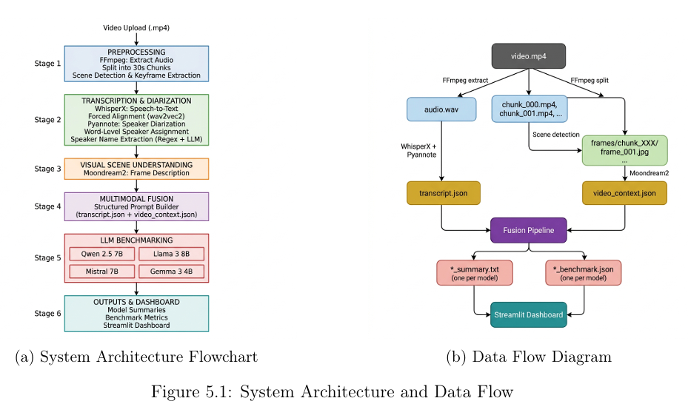
Architecture

Slide 17
References
[1] Breaking Down Authors. Breaking down video llm benchmarks: Knowledge, spatial, temporal. https://machinelearning.apple.com/research/breaking-down, 2024. Apple Machine Learning Research.
[2] Generating Minutes Authors. Generating minutes of meeting using llm. https://zenodo. org/records/13269298, 2023. Zenodo.
[3] J. Heseltine and co authors. Comparing large language models for text classification: Model selection across tasks, texts, and languages. https://sciety.org/articles/activity/ 10.31219/osf.io/jvgc5_v2, 2024. OSF.
[4] HourVideo Authors. Hourvideo: 1-hour video-language understanding. https://arxiv. org/abs/2411.04998, 2024. arXiv preprint arXiv:2411.04998.
[5] LongVideoBench Authors. Longvideobench: A benchmark for long-context interleaved video-language understanding. https://arxiv.org/abs/2407.15754, 2024. arXiv preprint arXiv:2407.15754.

Slide 18
References
[6] MeetingBank Authors. Meetingbank: A benchmark dataset for meeting summarization. https://arxiv.org/abs/2305.17529, 2023. ACL 2023.
[7] MISP-Meeting Authors. Misp-meeting: A real-world dataset with multimodal cues for long-form meeting transcription and summarization. https://aclanthology.org/2025. acl-long.753/, 2025. ACL 2025.
[8] OASIS Team. Oasis: On-demand hierarchical event memory for streaming video reasoning. https://arxiv.org/abs/2604.17052
[9] QMSum Authors. Qmsum: A new benchmark for query-based multi-domain meeting summarizationhttps://arxiv.org/abs/2104.05938
[10] Query-Based Authors. Query-based video summarization with pseudo label supervision. https://arxiv.org/abs/2307.01945.

Slide 19
References
[11] Scaling Up Authors. Scaling up video summarization pretraining with large language models. https://doi.org/10.48550/arXiv.2404.03398.
[12] Train enables Short Authors. zero-shot streamable Train joint short, asr infer and long: arXiv preprint Speech-llm diarization audio. on long https://www.microsoft.com
[13] Video Summarization Authors. Video summarization with long short-term memory. https://arxiv.org/abs/1605.08110
[14] Your Interest Authors. Your interest, your summaries: Query-focused long video summarization. https://arxiv.org/abs/2410.14087

Slide 20

Thank you

